Slide 1

Escape The IT
Biology-Chemisty Project
Aleksander Kostov, Nikolay Despotov,
Ivaylo Stoqnov, Denislave Bratoevski,
Andrey Mutlu

Slide 2
TABLE OF CONTENTS
01
02
03
04
Our Team
Technologies
Our Game
Stages

Slide 3
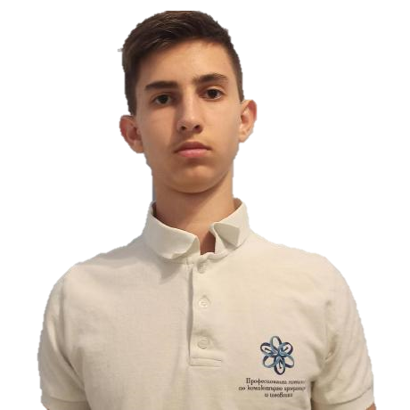

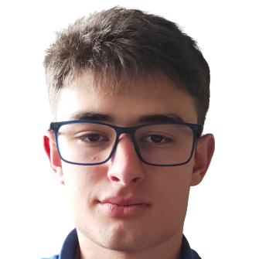
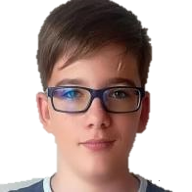
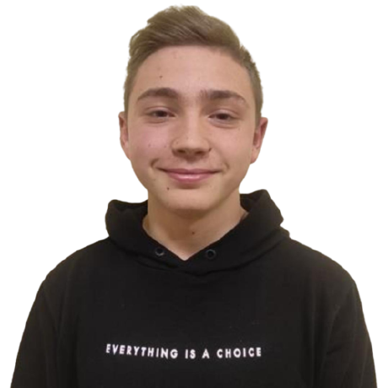
Our Team
N.Despotov
A.Kostov
I. Stoqnov
A.Mutlu
D.Bratoevski

Slide 4








Technologies

Slide 5
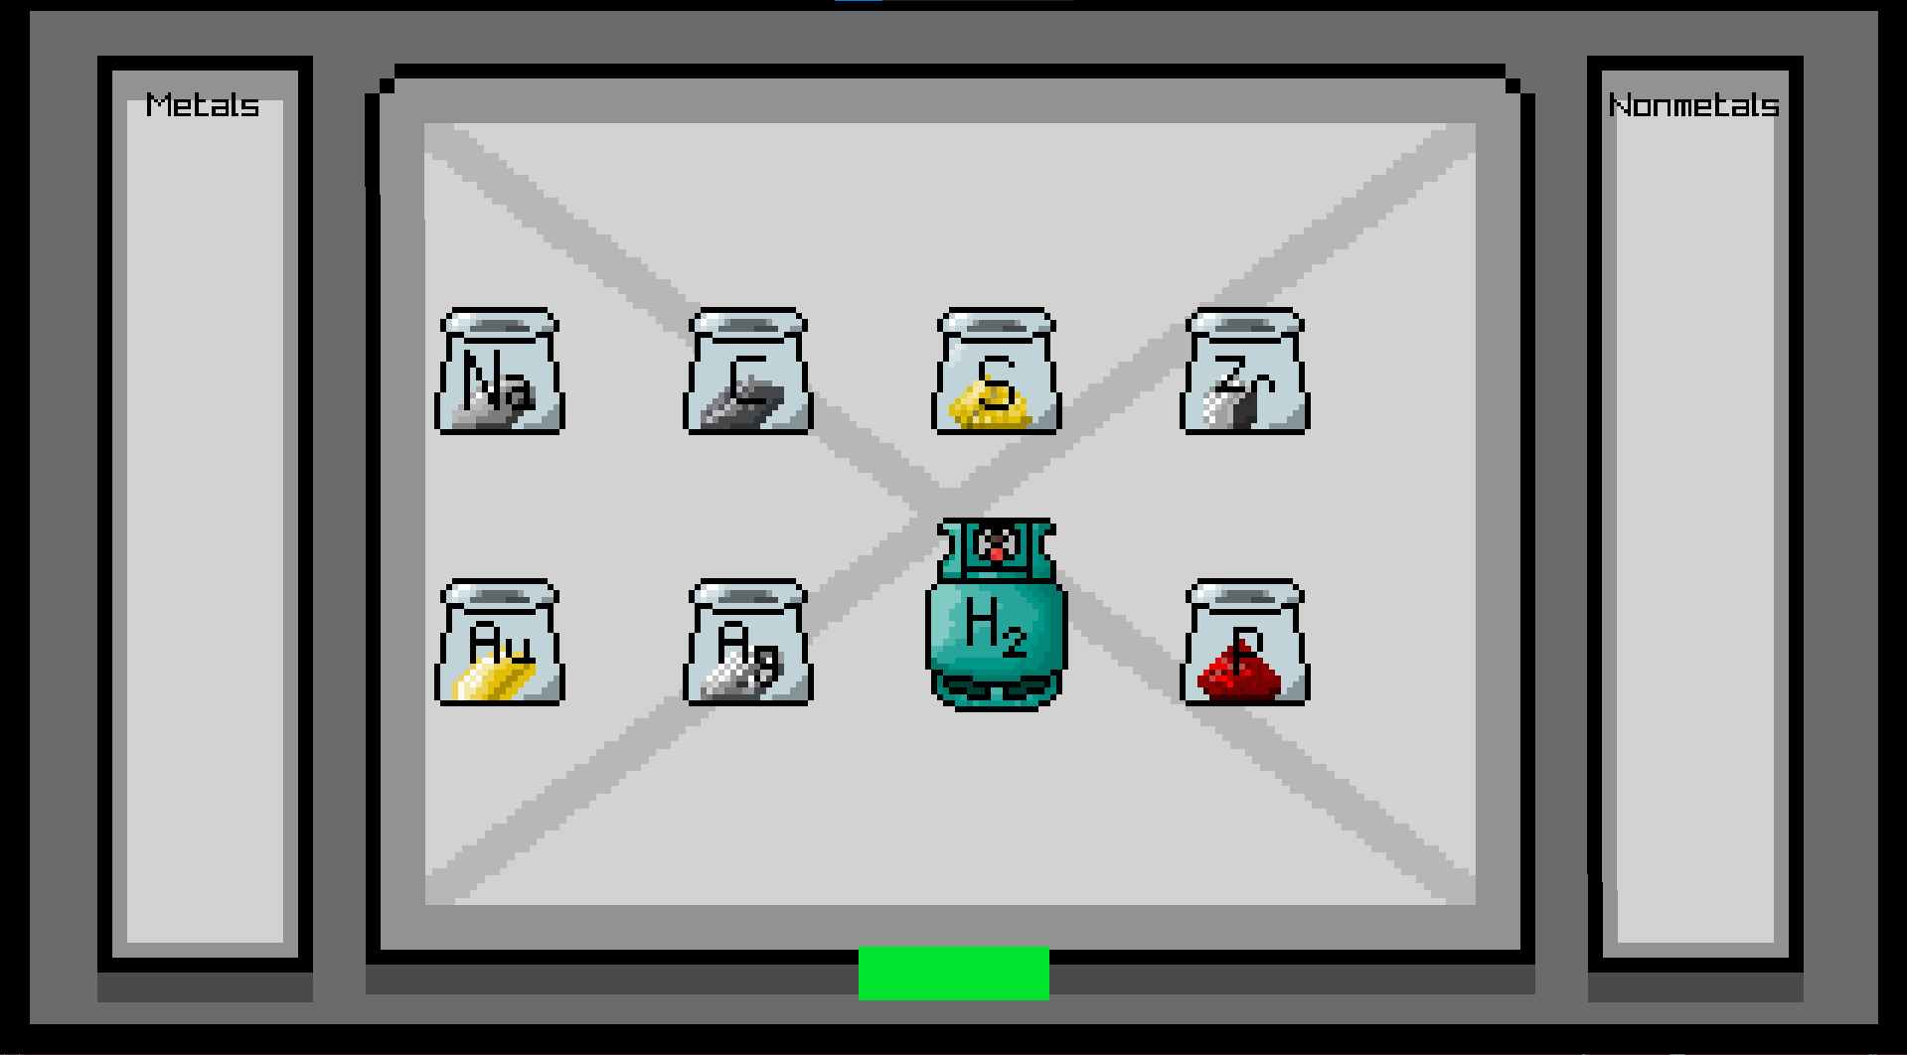
Our Game
Our idea was to make a game where you complete chemistry tasks and if you get the task wrong the chemistry teacher will start to chase you. Your mission is to escape the school by completing all tasks

Slide 6
Stages
Task
01
Project about Biology or Chemistry
Oraganisation
02
We gathered and discussed who will do what
Realization
03
We used C++ to implement the game

Slide 7
Let’s go to the game...

Slide 8
THANKS

